Slide 1
KHULNA UNIVERSITY OF ENGINEERING & TECHNOLOGY
Data Structure and Algorithm Laboratory
DSA - 2106
DHAKA RIDES
A Ride-Sharing System for Dhaka City
Fundamental data structures and algorithms, engineered together in C++
PRESENTED BY
SUBMITTED TO
Avik Hasan — 2407021
Bismoy Sarker — 2407008
Farhan Hossain — 2407019
Subah Nawar
Lecturer, KUET
Lamisa Bintee Mizan Deya
Lecturer, KUET
Notes:
Introduce the project and team. SOHOJJATRA is a console ride-sharing system whose every feature is powered by a hand-written data structure or algorithm.

Slide 2
Project overview
A console ride-sharing platform where every feature is backed by a DSA concept
What Book rides across 62 Dhaka locations with route, fare and driver matching.
Problem Find the nearest driver, a valid route, and a fair price — quickly and in order.
Features Route analysis, surge pricing (traffic · weather · demand), wallet top-up approval, trip history, admin analytics.
Users Riders, drivers and an admin console.
Why DSA 1,000+ drivers and a road network need structures chosen for the job, not default containers.
Rider
book · wallet · history
Driver
online · location · earnings
DHAKA RIDES
core system
62
locations
1000+
drivers
120+
riders
Admin
users · pricing · analytics
DSA-2106 · KUET · DHAKA RIDES
Map
Linear
Graph
Trees
Sort
Demo
Summary
Notes:
Three roles: Rider, Driver, Admin. Data persists in CSV files. Numbers are taken from the project data files: 62 locations in the road graph, ~1000 drivers in drivers.csv, ~120 riders in users.csv.

Slide 3
System architecture & workflow
User → Input → Core system → Data structures → Algorithms → Output
User
Rider · Driver · Admin
Input
Console menus + CSV files
Core system
Auth · Rider · Driver · Admin · Payment
Data structures
Vector · Queue · Stack · DLL · Graph · BST · Heap
Algorithms
BFS · DFS · Binary search · Sorts
Output
Route · fare · history · reports
WHO OWNS WHAT
CityGraph
graph.cpp
DLL adjacency list · BFS · DFS
RiderModule
rider.cpp · stack.cpp
Singly list favourites · Stack history
DriverModule
driver.cpp
Vector · Binary search · Merge sort
PaymentSystem
payment.cpp · queue.cpp
FIFO queue of wallet top-ups
AdminModule
admin.cpp
BST lookup · Selection sort
BOOKING PIPELINE (main.cpp)
DFS
is destination reachable?
BFS
shortest route (hops)
Min Heap
nearest, best-rated driver
Fare
base + km + surge
rides.csv
ride logged for history
DSA-2106 · KUET · DHAKA RIDES
Map
Linear
Graph
Trees
Sort
Demo
Summary
Notes:
Walk the audience left to right. The lower cards show which module owns which structure. The strip at the bottom is the real booking pipeline in main.cpp: DFS reachability, BFS route, MinHeap driver match, fare.

Slide 4
DSA implementation map
DSA concept | Project module | Purpose in DHAKA RIDES | Role
Dynamic Array | vector.hpp (everywhere) | Resizable storage for cities, drivers, riders, paths | Core
Queue | queue.hpp · payment.cpp | Wallet top-ups (FCFS) and BFS frontier | Core
Stack | stack.cpp | Trip history, most recent first | Core
Doubly Linked List | graph · stack · queue (.hpp) | Edge lists and nodes of stack / queue | Core
Graph | graph.cpp (CityGraph) | 62 locations, weighted undirected roads | Core
BFS | graph.cpp (bfsPath) | Route with fewest hops; driver-to-pickup distance | Core
DFS | graph.cpp (dfsPath) | Reachability check + alternative route | Core
BST | bst.cpp · admin.cpp | Admin user lookup by ID | Admin
Binary Search | bst.cpp · driver.cpp | Admin driver lookup by ID (sorted array) | Admin
Min Heap | heap.cpp · main.cpp | Nearest driver; tie → higher rating | Core
Merge Sort | sorting.cpp | Driver leaderboard (rating, then trips) | Admin
Selection Sort | sorting.cpp | Demand heatmap, descending | Admin
+ Singly Linked List | linkedlist.hpp | Favourite locations; wallet request log | Core
Core = booking / payment flow Admin = lookups & analytics Not used: Dijkstra, AVL trees, hash tables
DSA-2106 · KUET · DHAKA RIDES
Map
Linear
Graph
Trees
Sort
Demo
Summary
Notes:
Every row links to its slide. Core = part of the rider booking/payment flow. Admin = analytics and lookups. Not used: Dijkstra / weighted shortest path, balanced trees (AVL/Red-Black), hash tables.

Slide 5
Dynamic array — custom Vector<T>
A resizable array built from new[] / delete[], with doubling growth
Where cities, drivers, riders, adjacency heads, route paths — every collection.
Why Sizes change at runtime (sign-ups, new cities); contiguous memory gives O(1) indexing.
Ops push_back · operator[] · erase · resize (private).
vector.hpp
void push_back(const T& val) {
if (count >= cap) resize(cap * 2);
data[count++] = val;
}
void resize(int newCap) {
T* newData = new T[newCap];
for (int i = 0; i < count; i++)
newData[i] = data[i];
delete[] data;
data = newData; cap = newCap;
}
capacity 4 → full → push_back triggers resize(cap * 2)
A
B
C
D
count 4 / cap 4
new T[8] · copy · delete[] old
Access [i]
O(1)
push_back
O(1) amortised
A
B
C
D
E
count 5 / cap 8
erase
O(n) shift
Space
O(n)
DSA-2106 · KUET · DHAKA RIDES
Map
Linear
Graph
Trees
Sort
Demo
Summary
Notes:
Vector replaces std::vector everywhere. Initial capacity is 4. When count reaches capacity, resize(cap*2) allocates a bigger block, copies elements, and frees the old block. Amortised O(1) push_back.

Slide 6
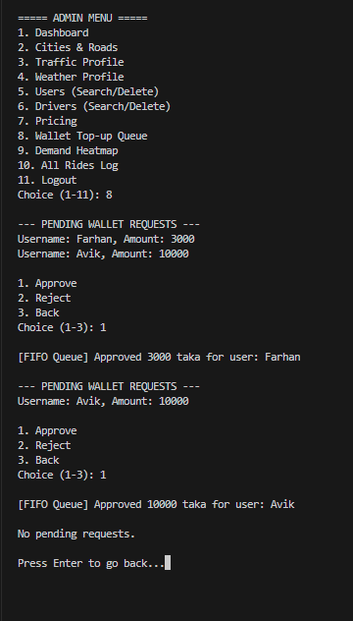
Queue — FIFO
First in, first out: two queues, one idea of fairness and ordering
Wallet queue Top-up requests wait in FIFO order; admin approves the oldest first.
BFS queue Holds the frontier of cities during route search (slide 9).
Ops enqueue at rear · dequeue from front · isEmpty.
ADMIN › WALLET TOP-UP QUEUE (from demo)
Farhan
3000
Avik
10000
next…
FRONT
REAR
← dequeue from front
enqueue at rear →
WalletRequestQueue::enqueue
enqueue
O(1)
WalletQueueNode* newNode = new WalletQueueNode(data);
if (isEmpty()) {
frontNode = rearNode = newNode;
} else {
rearNode->next = newNode;
newNode->prev = rearNode;
rearNode = newNode;
}
dequeue
O(1)
Space
O(n)
Admin approves in arrival order
DSA-2106 · KUET · DHAKA RIDES
Map
Linear
Graph
Trees
Sort
Demo
Summary
Notes:
Two queue classes share one design: a doubly-linked list with front and rear pointers. WalletRequestQueue gives first-come-first-served approval; BFSQueue holds the BFS frontier. The screenshot shows Farhan (3000) approved before Avik (10000).

Slide 7
Doubly linked list & stack (LIFO)
The stack's nodes are doubly linked — push and pop happen only at the top
RideStackNode: RideRecord data · prev · next
STACK (LIFO)
Ride 3
newest
Ride 2
Ride 1
oldest
push → Ride 3 (top)
NULL
NULL
Ride 2
topNode
Ride 1 (bottom)
Why DLL Each node knows prev & next — O(1) relink when removing from the top.
Where Stack, queues and the graph's edge lists all reuse this node design.
Stack use displayTripHistory pushes rides.csv rows, then pops: newest ride prints first.
Note No peek() in the project: push · pop · isEmpty · clear.
pop ← prints Ride 3 first
RideHistoryStack::push
RideStackNode* newNode = new RideStackNode(data);
if (topNode) {
newNode->next = topNode;
topNode->prev = newNode;
}
topNode = newNode;
push / pop
O(1)
print history
O(n)
Space
O(n)
DSA-2106 · KUET · DHAKA RIDES
Map
Linear
Graph
Trees
Sort
Demo
Summary
Notes:
RideStackNode, WalletQueueNode, BFSQueueNode and EdgeNode are all doubly linked nodes with prev/next. The stack is used to show trip history newest-first: rides.csv is chronological, so pushing then popping reverses the order. The project has no peek(); only push, pop, isEmpty, clear. Favourite locations use a singly linked list (insertAtTail, deleteNode).

Slide 8
Graph — Dhaka road network
Locations are vertices; roads are weighted, undirected edges (km)
Tejgaon
Vertices 62 locations — Vector<string> cities.
Edges Roads with distance in km (double weight); undirected, weighted.
Storage Adjacency list: Vector<EdgeNode*>, each a doubly linked list.
Why Road network is sparse — O(V+E) space beats a 62×62 matrix.
Shewrapara
0.88
Nakhalpara
2.09
1.98
0.62
1.9
Agargaon
Kazipara
CityGraph::addRoad
1.91
int u[2] = {from, to};
int v[2] = {to, from};
for (int i = 0; i < 2; i++) {
EdgeNode* node = new EdgeNode(v[i], weight,
nullptr, adjList[u[i]]);
if (adjList[u[i]]) adjList[u[i]]->prev = node;
adjList[u[i]] = node;
}
Dhanmondi
2.21
2.09
2.08
Kallyanpur
Mohammadpur
2.34
addRoad
O(1)
removeRoad
O(deg)
Space
O(V+E)
from connected_nodes.csv (km)
DSA-2106 · KUET · DHAKA RIDES
Map
Linear
Graph
Trees
Sort
Demo
Summary
Notes:
The diagram is a real neighbourhood from connected_nodes.csv: Agargaon connects to five neighbours with the weights shown. The graph is stored as an adjacency list: a Vector of doubly linked list heads. addRoad inserts the edge in both directions, so the graph is undirected.

Slide 9
Breadth-first search — route finding
Level by level with a FIFO queue: the first arrival is the fewest-hops route
Level 0
Level 1
Level 2
Level 3
Use Rider route in booking; driver-to-pickup distance in matching.
Kallyanpur
Mohammadpur
CityGraph::bfsPath (excerpt)
BFSQueue q;
visited[start] = true;
q.enqueue(start);
while (!q.isEmpty()) {
int curr = q.dequeue();
if (curr == goal) { reached = true; break; }
for (EdgeNode* e = adjList[curr]; e; e = e->next)
if (!visited[e->dest]) {
visited[e->dest] = true;
parent[e->dest] = curr;
q.enqueue(e->dest);
Agargaon
Tejgaon
Farmgate
Dhanmondi
+3 more
+ more
Route: Agargaon → Kallyanpur → Mohammadpur → Dhanmondi
QUEUE STATE
start
[ Agargaon ]
dequeue Agargaon
[ Kallyanpur · Tejgaon · … ]
Time
O(V+E)
Space
O(V)
visited · parent · queue
Honest note: BFS minimises hops; km = sum of edge weights on that path.
DSA-2106 · KUET · DHAKA RIDES
Map
Linear
Graph
Trees
Sort
Demo
Summary
Notes:
BFS is used twice: for the rider's route and for each candidate driver's distance to the pickup point. Honest note: BFS minimises hops, not kilometres. The distance shown is the sum of edge weights along the BFS path. Level layout is derived from connected_nodes.csv for Agargaon to Dhanmondi.

Slide 10
Depth-first search — reachability
Go as deep as possible, backtrack on dead ends; recursion is the stack
illustrative walk
B
Use Booking step 1: is the destination reachable? Also gives an alternative route.
How Recursive; the system call stack replaces an explicit stack.
A
3 ✕
S
2
C
Goal
CityGraph::dfsHelper (if wrapped)
1
visited[curr] = true;
path.push_back(curr);
if (curr == goal) return true;
for (EdgeNode* e = adjList[curr]; e; e = e->next) {
if (!visited[e->dest] &&
dfsHelper(e->dest, goal, visited, path)) {
return true;
}
}
path.pop_back();
return false;
D
4
5 ✓
D unvisited
B is a dead end → pop_back, backtrack to A, try C
CALL STACK AT GOAL
dfs(S)
dfs(A)
dfs(C)
dfs(Goal)
bottom → top
Time
O(V+E)
Space
O(V) stack
DSA-2106 · KUET · DHAKA RIDES
Map
Linear
Graph
Trees
Sort
Demo
Summary
Notes:
DFS runs first in booking: if no path exists, the ride is cancelled. Its path is shown as an alternative only when its length differs from the BFS route. The diagram is an illustrative walk, not project output.

Slide 11
BST & binary search — lookup by ID
BST user ID → username · avg O(log n)
Binary search driver ID · O(log n)
1
50
Search ID 700 among 1000 sorted IDs (illustrative)
[1 … 1000] mid = 500 → go right
2
30
70
[501 … 1000] mid = 750 → go left
3
20
40
4
[501 … 749] mid = 625 → go right
Balanced (ideal)
Actual: IDs inserted 1, 2, 3 … → skewed
… found after 9 probes (worst case ⌊log₂ 1000⌋ + 1 = 10)
Insert · search · remove (recursive) on UserBSTNode(id, username).
Skewed today → O(n); balancing is future work.
if (low > high) return -1;
int mid = low + (high - low) / 2;
if (arr[mid].id == targetId) return mid;
if (arr[mid].id > targetId)
return binarySearchRecursive(arr, low,
mid - 1, targetId);
return binarySearchRecursive(arr, mid + 1,
high, targetId);
if (!node || node->id == id) return node;
if (id < node->id)
return searchHelper(node->left, id);
return searchHelper(node->right, id);
DSA-2106 · KUET · DHAKA RIDES
Map
Linear
Graph
Trees
Sort
Demo
Summary
Notes:
BST: admin user lookup, built by inserting riders in file order (IDs ascend), so today's tree is right-skewed: search is effectively O(n) until a self-balancing tree is used. Binary search: driver IDs are assigned sequentially so the drivers vector is sorted by id, which is the precondition. The probe sequence is computed for a hypothetical search of ID 700 among IDs 1..1000.

Slide 12
Min heap — nearest-driver matching
A priority queue keeps the best candidate at the root, ready in O(log K)
illustrative distances (km)
Use matchDriver: pick the nearest, best-rated free driver for the chosen vehicle.
Why Priority order without sorting every candidate.
Ops push (sift up) · extractMin (heapify down).
1.2
root = nearest driver
1.9
2.5
matchDriver (main.cpp)
minHeap.push(HeapItem(dArr[d], dist,
dr.avgRating));
return minHeap.isEmpty() ? -1 :
minHeap.extractMin().driverIndex;
3.1
2.6
DriverMatchingMinHeap::extractMin
ARRAY arr[ ] (parent = (i−1)/2)
HeapItem closest = arr[0];
arr[0] = arr[n - 1];
n--;
heapify(0);
return closest;
1.2
1.9
2.5
3.1
2.6
0
1
2
3
4
Order: smaller distance wins; equal distance → higher rating wins
push
O(log K)
extractMin
O(log K)
K BFS runs dominate: O(K·(V+E))
DSA-2106 · KUET · DHAKA RIDES
Map
Linear
Graph
Trees
Sort
Demo
Summary
Notes:
matchDriver filters free drivers of the chosen vehicle, runs BFS from each driver's location to the pickup to get a distance, pushes (driverIndex, distance, rating) into the heap, and extracts the minimum. Ordering: smaller distance first; equal distance: higher rating. Heap values in the diagram are illustrative. The heap is a fixed array of 1100 items.

Slide 13
Sorting — merge sort & selection sort
Merge sort driver leaderboard · O(n log n)
Selection sort demand heatmap · O(V²)
4.2
5.0
4.7
4.9
input
4
12
5
3
max = 12 → swap to front
4.2
5.0
4.7
4.9
split
12
4
5
3
max of rest = 5 → swap
5.0
4.2
4.9
4.7
merge pairs
12
5
4
3
max of rest = 4 → swap
5.0
4.9
4.7
4.2
merge → sorted
12
5
4
3
sorted
illustrative ratings, best first
selectionSortDemandDesc · illustrative counts, outlined = max
mergeSortDriverLeaderboard
for (int i = 0; i < n - 1; i++) {
int maxIdx = i;
for (int j = i + 1; j < n; j++) {
if (items[j].count > items[maxIdx].count) {
maxIdx = j;
}
}
if (maxIdx != i) {
swap(items[i], items[maxIdx]);
}
}
if (left >= right) return;
int mid = left + (right - left) / 2;
mergeSortDriverLeaderboard(arr, left, mid,
drivers);
mergeSortDriverLeaderboard(arr, mid + 1,
right, drivers);
mergeDrivers(arr, left, mid, right, drivers);
Time
O(n log n)
Aux space
O(n)
ties: more trips wins
DSA-2106 · KUET · DHAKA RIDES
Map
Linear
Graph
Trees
Sort
Demo
Summary
Notes:
Merge sort ranks the driver leaderboard: guaranteed O(n log n), compares by average rating then trip count (isBetterDriver). It sorts an int index array, not the driver objects. Selection sort orders the demand heatmap descending; with only 62 locations, O(V^2) is fine and it needs O(1) extra space. Input values in the diagrams are illustrative; the real heatmap output puts Agargaon (12 requests) on top.

Slide 14
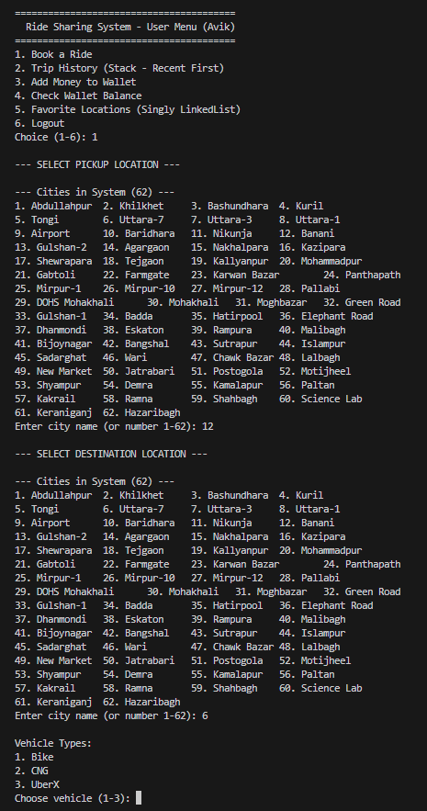
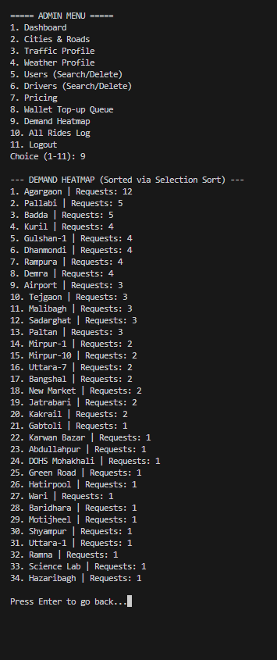
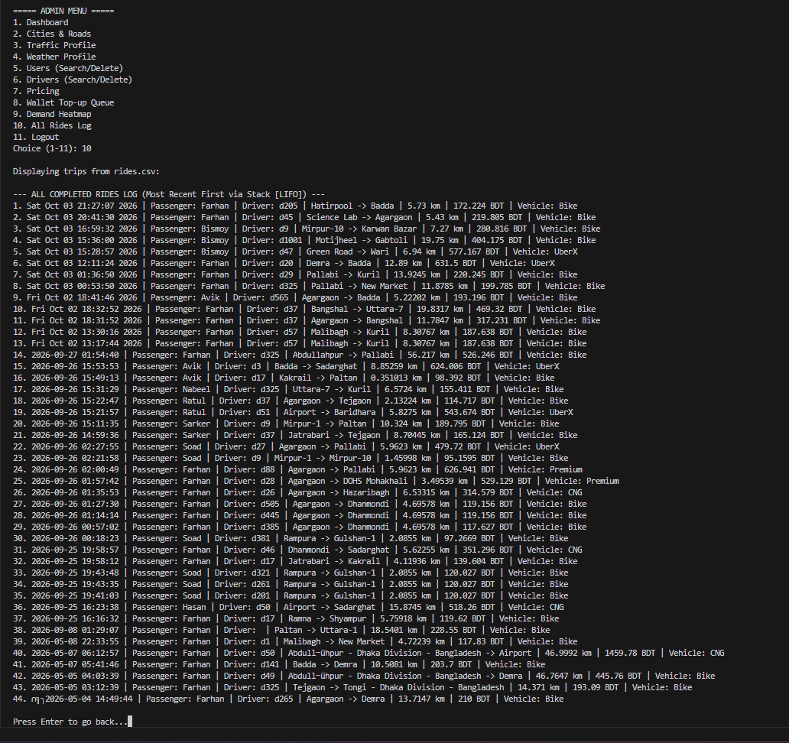
Project in operation
Input → data structure / algorithm → processing → output, from the running program
Book a ride
Banani → Uttara-7, vehicle prompt
Vector (cities) → DFS → BFS → Min Heap
Wallet top-up queue
Farhan 3000 approved before Avik 10000
Queue (FIFO)
Demand heatmap
Agargaon, 12 requests, ranked first
Selection sort
All rides log
Newest ride (Oct 03) printed first
Stack (LIFO) on a doubly linked list
DSA-2106 · KUET · DHAKA RIDES
Map
Linear
Graph
Trees
Sort
Demo
Summary
Notes:
All screenshots are from the running console application. Booking: the city list comes from the Vector of cities; after the vehicle choice the pipeline runs DFS, BFS, heap match. Wallet: FIFO approval of Farhan before Avik. Rides log: stack pops newest first. Heatmap: selection sort puts Agargaon on top.

Slide 15
Complexity summary
Structure / algorithm | Main operation | Time complexity | Project usage
Dynamic Array | Access / push_back / erase | O(1) / amortised O(1) / O(n) | All collections
Queue | Enqueue / dequeue | O(1) | Wallet requests, BFS frontier
Stack | Push / pop | O(1) | Trip history (print: O(n))
Doubly Linked List | Insert head / unlink node | O(1) / O(1) | Edge lists, stack & queue nodes
Singly Linked List | Insert tail / delete / getAt | O(1) / O(n) / O(n) | Favourites, request log
Graph (adj. list) | addRoad / removeRoad | O(1) / O(deg) | Road network; space O(V+E)
BFS | Traversal | O(V+E) | Route, driver distance
DFS | Traversal | O(V+E) | Reachability, alt. route
BST | Search / insert | avg O(log n), worst O(n) | Worst case today (sequential IDs)
Binary Search | Search | O(log n) | Driver lookup by ID
Min Heap | Push / extract-min | O(log K) | Driver matching (K drivers)
Merge Sort | Sorting | O(n log n) | Driver leaderboard
Selection Sort | Sorting | O(V²) | Demand heatmap (V = 62)
n = elements · V = locations (62) · E = roads · K = candidate drivers · deg = neighbours of one location
DSA-2106 · KUET · DHAKA RIDES
Map
Linear
Graph
Trees
Sort
Demo
Summary
Notes:
Complexities are for this implementation. BST worst case applies today because IDs are inserted in ascending order. Singly linked list getAt is O(n) because it walks from the head.

Slide 16
Conclusion
A practical demonstration of how fundamental DSA, engineered together, solves a real computational problem
Implemented
What we learned
Next steps
Custom Vector, queues, stack, linked lists
Weighted graph with BFS and DFS
Min heap, BST, binary search
Merge and selection sort
Match the structure to the operation
Structures compose: queue + graph = BFS; heap + BFS = matching
Recursion and pointer relinking in practice
Performance: O(1) queue/stack ops, O(V+E) traversals, O(log K) heap
Self-balancing BST (AVL) for user lookup
Dijkstra for true shortest distance
Hash map for username lookup
Avoid one BFS per candidate driver
Thank You
Questions & Discussion
Avik Hasan · Bismoy Sarker · Farhan Hossain
Notes:
Close with the central message: this is a demonstration of fundamental data structures and algorithms engineered together. Be ready to discuss the skewed BST and the BFS hops-versus-kilometres limitation.

